Slide 1


Smart Irrigation System
Stefano Sacchet
Matteo Mascherin Lorenzo Dongili
Embedded Software for the Internet of Things project

Slide 2
Problem Statement
What the project aims at?
Automatic offline irrigation system
Real time data from sensors
Internet of Things expansion to store data in a database
Telegram Bot to have an online and remote control on the system

Slide 3
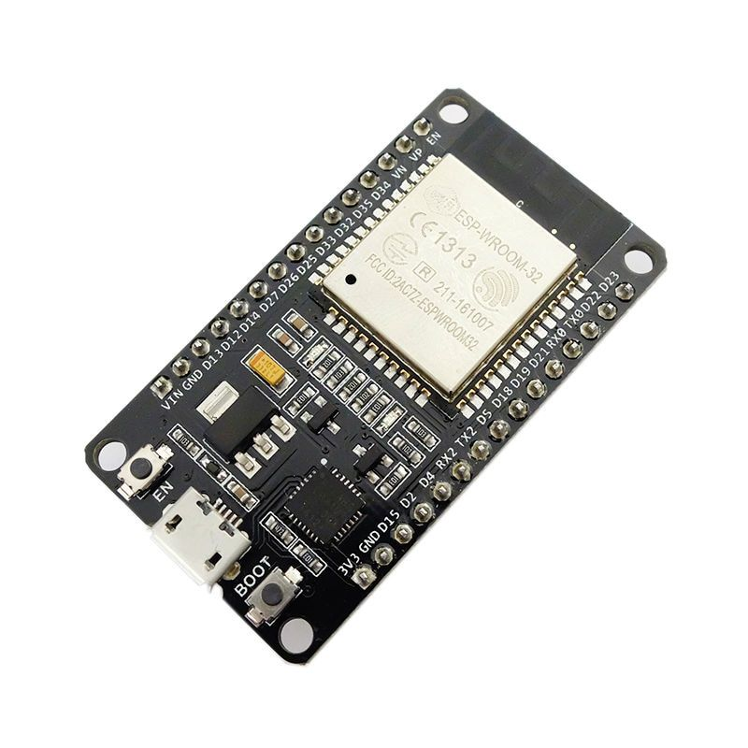
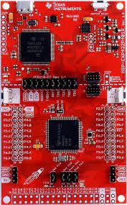
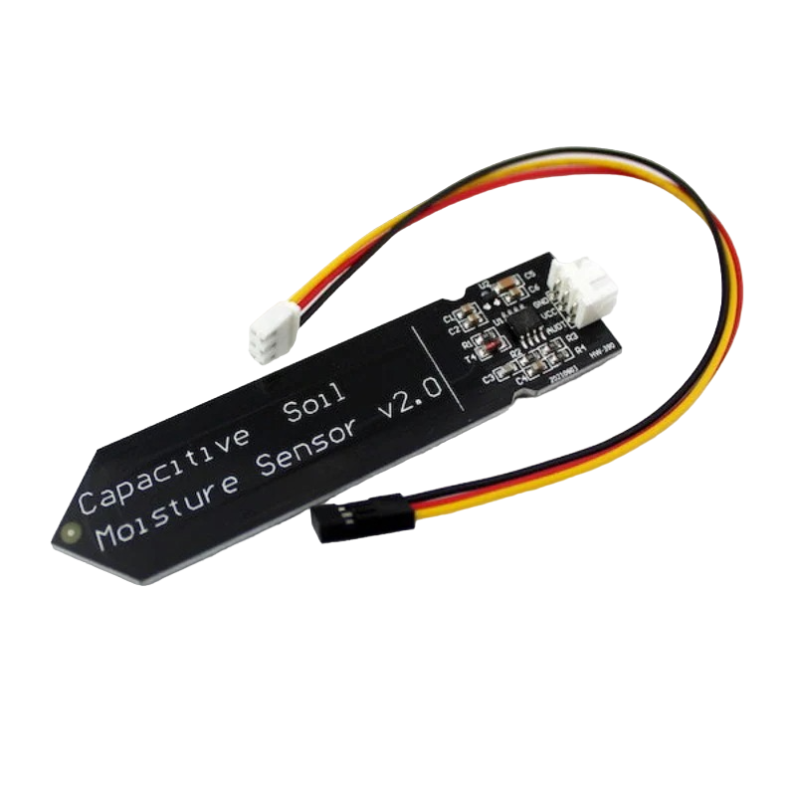
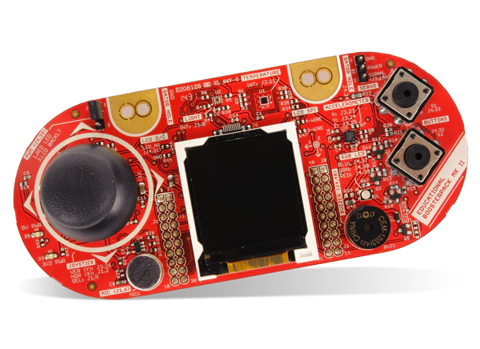
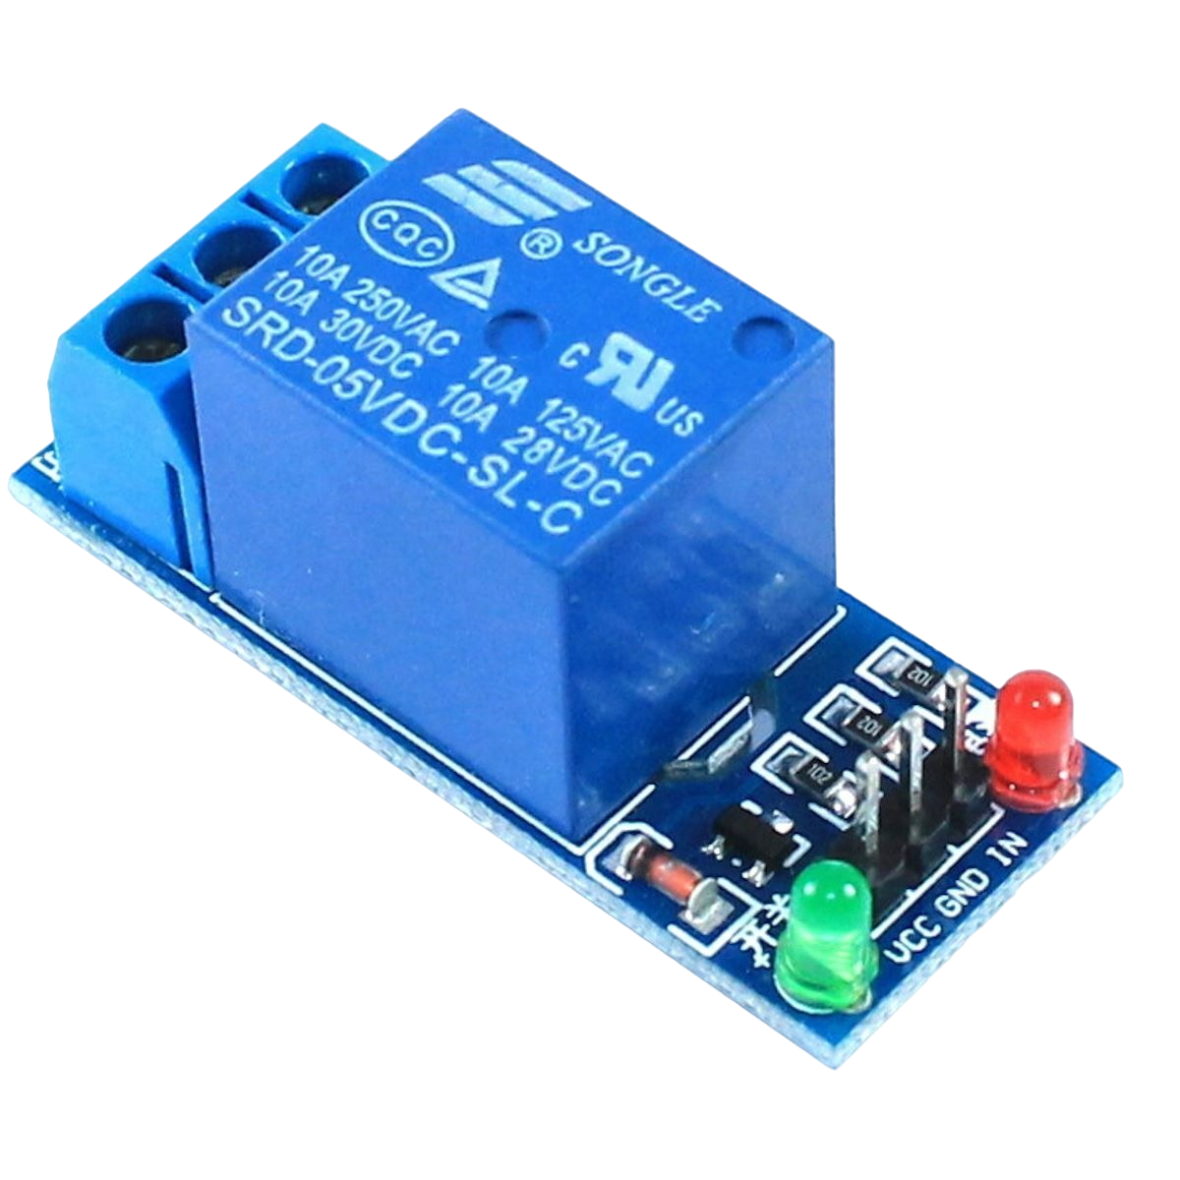
Hardware used
MSP432p401r
ESP32
Soil moisture sensor
Boosterpack-EDUMMKll
3.3 V Relay

Slide 4
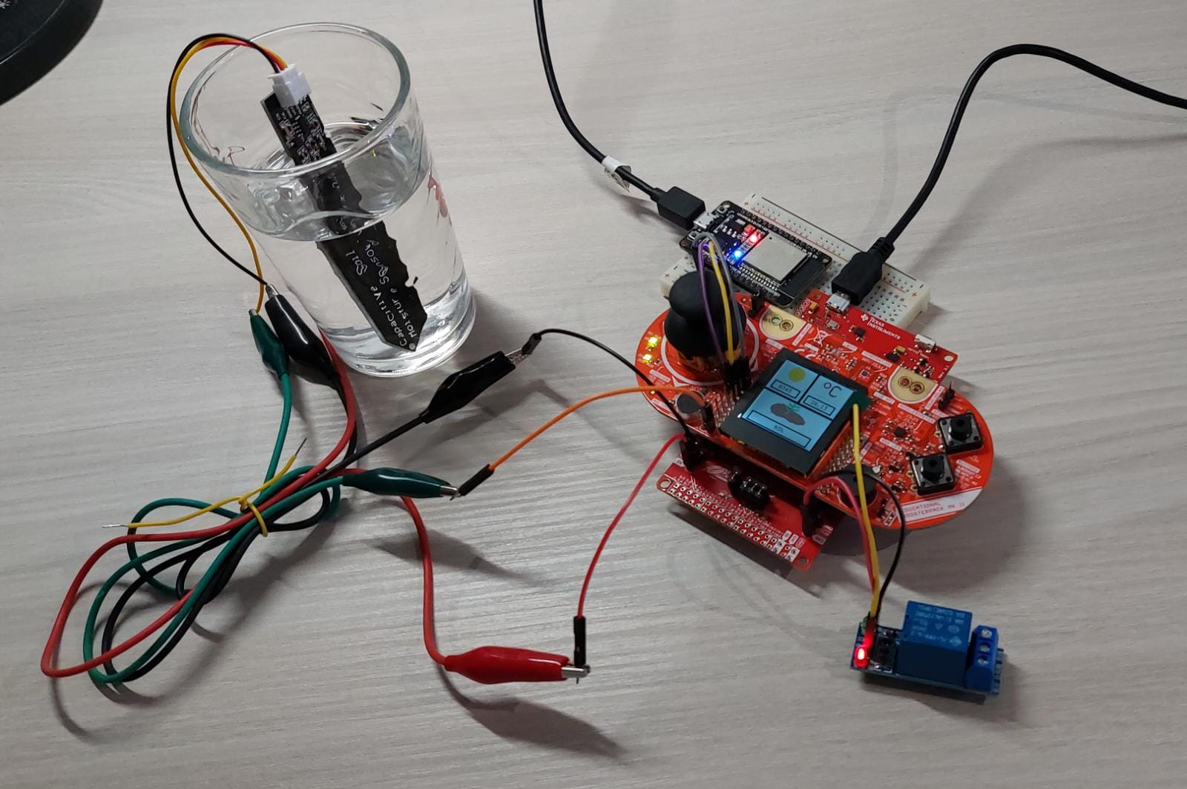
Our system
ESP32
Light sensor
Temperature sensor
Moisture sensor
LCD display
5V Relay

Slide 5
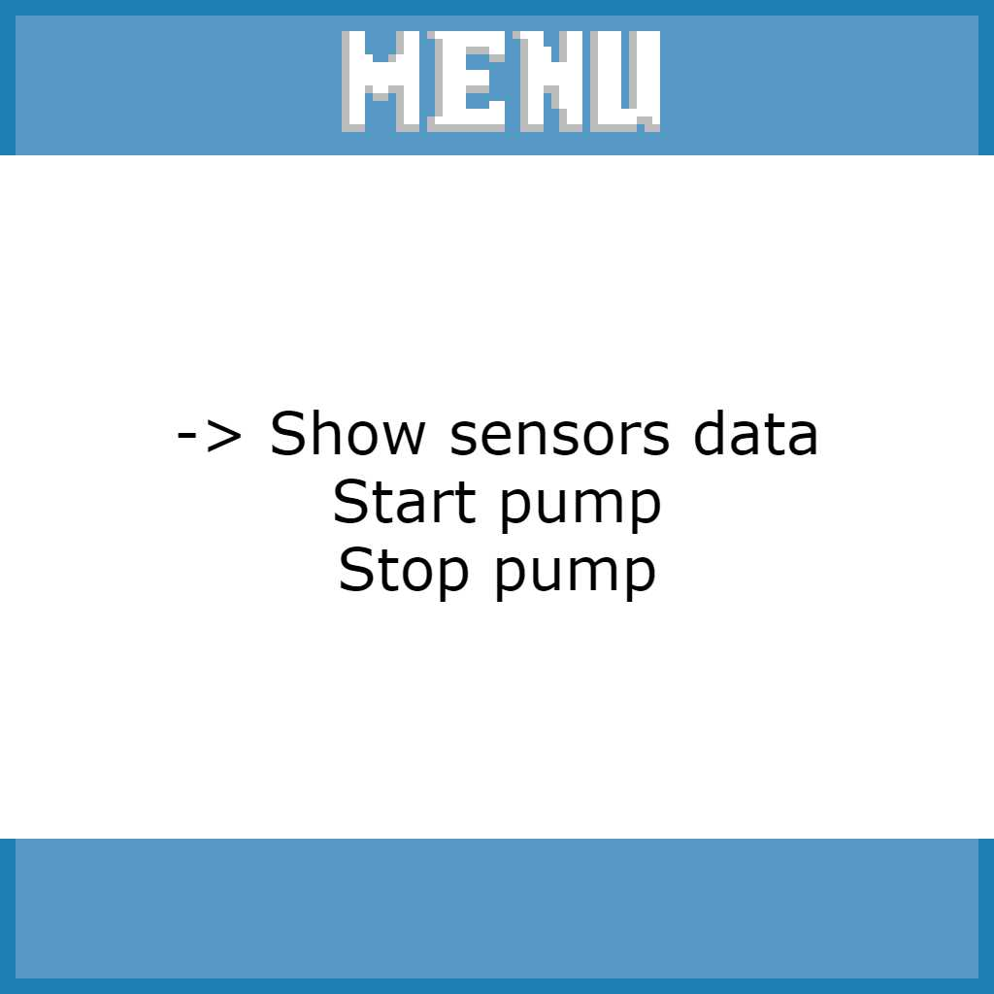
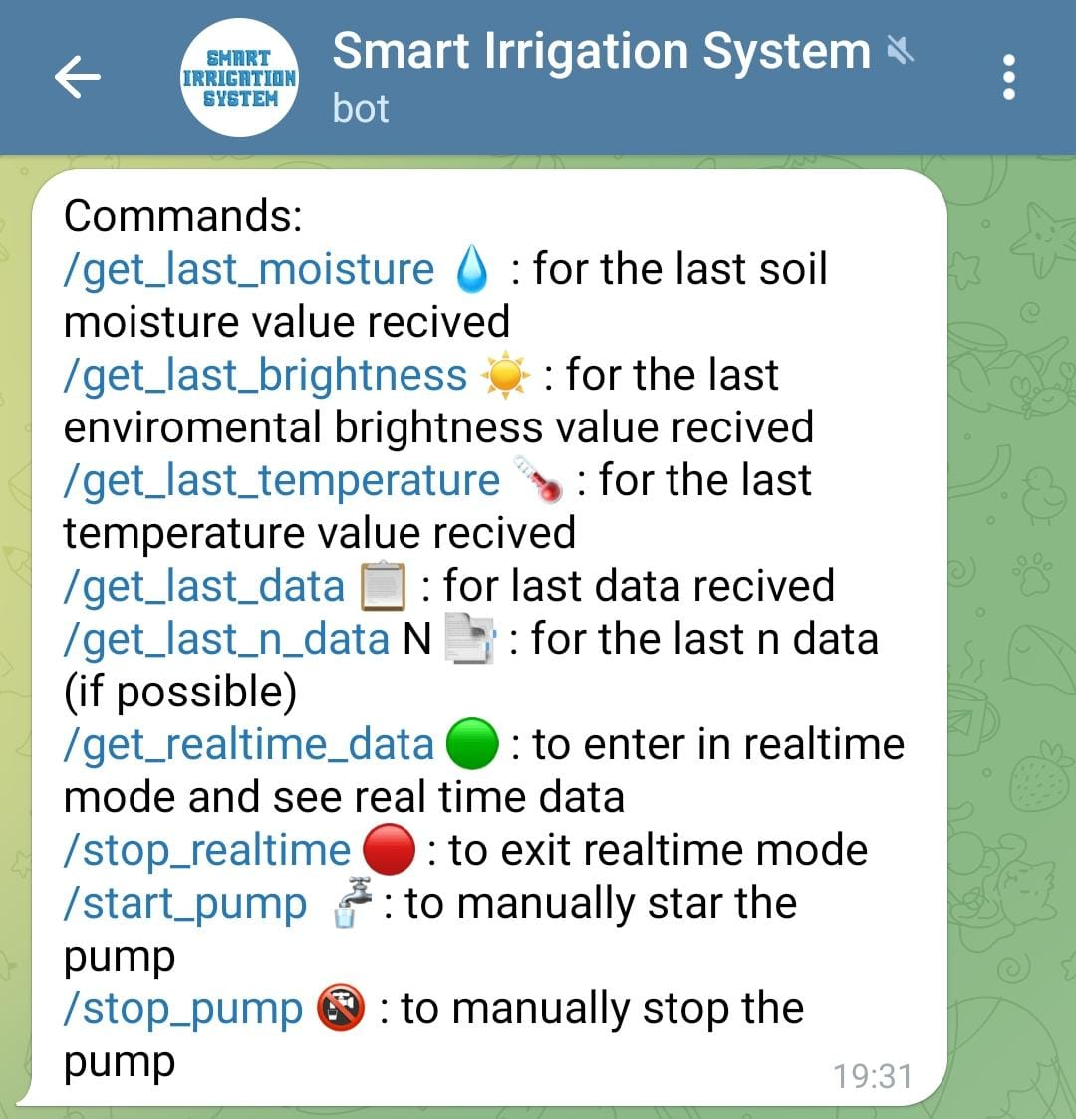
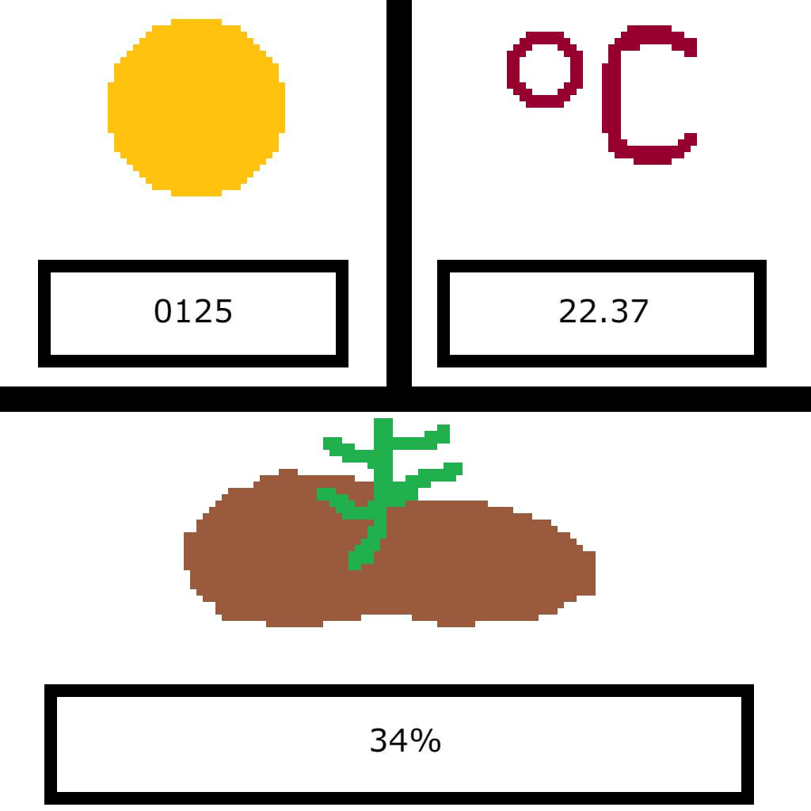
Working Scheme:
User interaction
Offline, using Boosterpack controller
Remotely, using Telegram bot.
Automatic mode, based on sensor values.

Slide 6
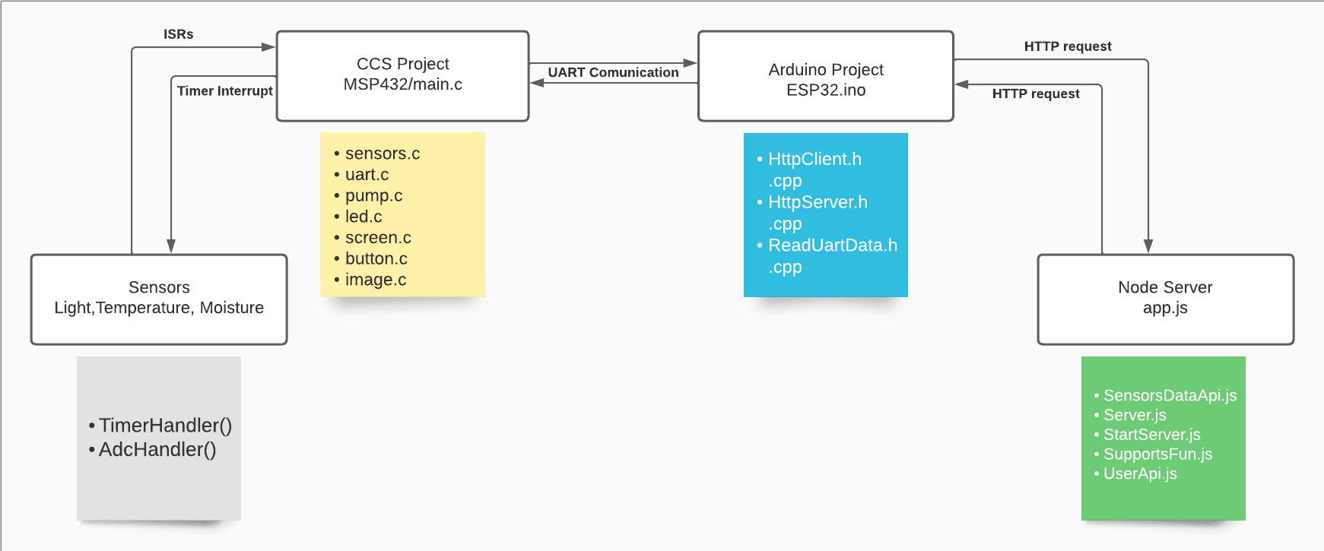
Software architecture

Slide 7
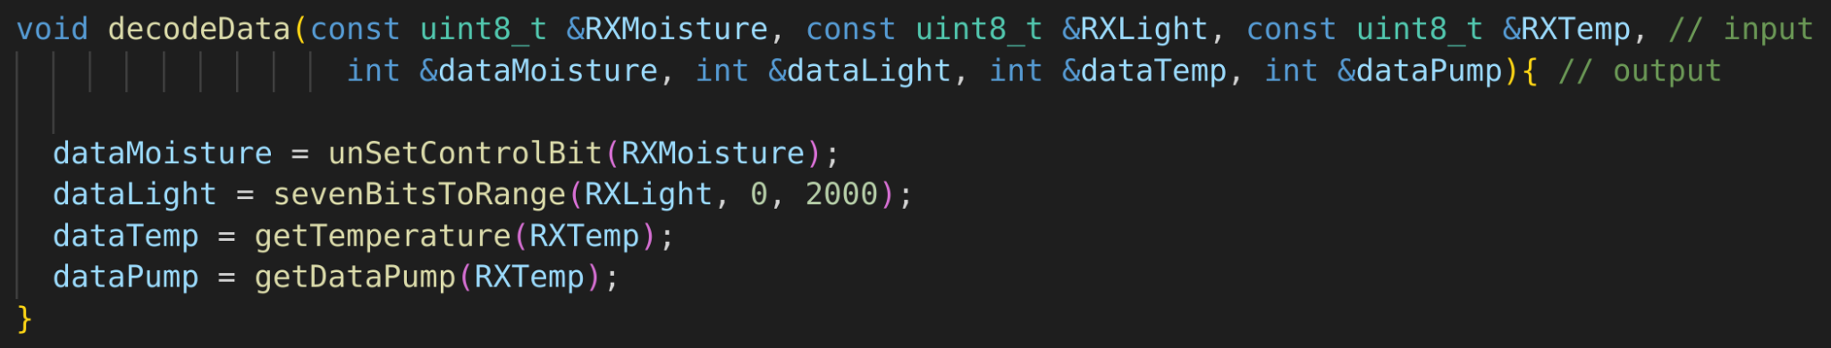
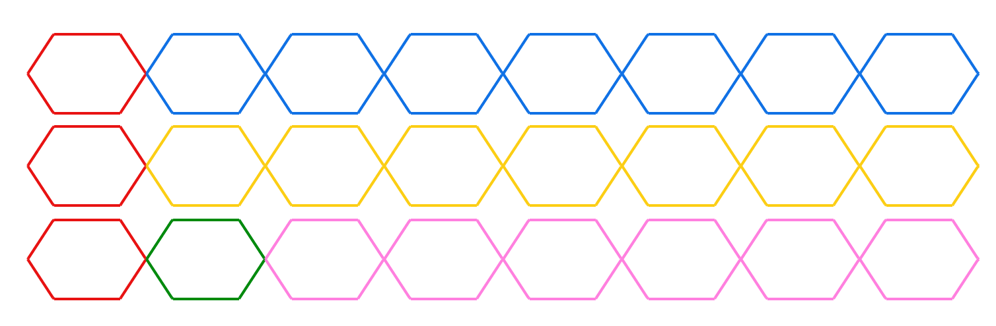
Some code snippets
control bit
dag
gadg
adg
adg

Slide 8

Problems, problems
oSolutionslems, problems
Serial communication
Moisture mapping
Interactive menu display
Wireless connection
Data mapping
Real data sampling
Debugging
WiFi manager

Slide 9


TESTING
Separate testing of the software components on host machine
Sensors mapping
Code integration of the different modules
Final testing on the target machine with all sensors connected

Slide 10

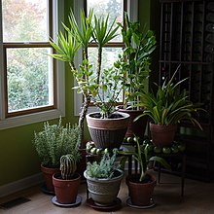
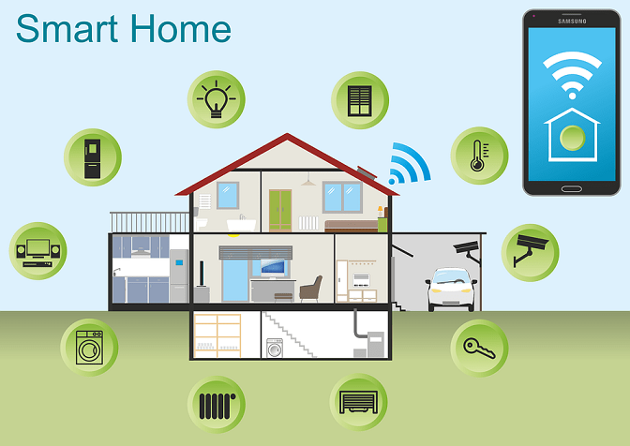
Conclusions and Future Work
Some custom routine to improve automatic irrigation
Adding plant information to improve system flexibility
Integration of the system in a larger and centralized Environment

